Slide 1


Session no. 20
Subject: Engineering Chemistry
Course Code: ETCH104
Program: B.Tech. CSE (Full Stack/IBM/DS) SEM-I
Faculty Name: Dr. Divyanshi Mangla
(Assistant Professor)
School of Basic and Applied Sciences

Slide 2

Table of Contents
Pre-requisite
Electrochemical Cells
Quiz
Support Material

Slide 3
Pre-requisite
Basic knowledge of Class 12th Chemistry
Electrode potential
Redox reactions

Slide 4
Course Outcomes
CO1 | Understand the methods for water hardness and the basics of boiler water treatment and analyze fuel calorific values and battery. | BTL2
CO2 | Explain the characteristics and working principles of different battery types and types of fuels. | BTL2
CO3 | Determine the differences between batteries and fuel cells and classify fuel cell types based on their components. | BTL4
CO4 | Identify between hard and soft water, solve the related numerical problems on water purification and emf and its significance in industry and daily life. | BTL3

Slide 5
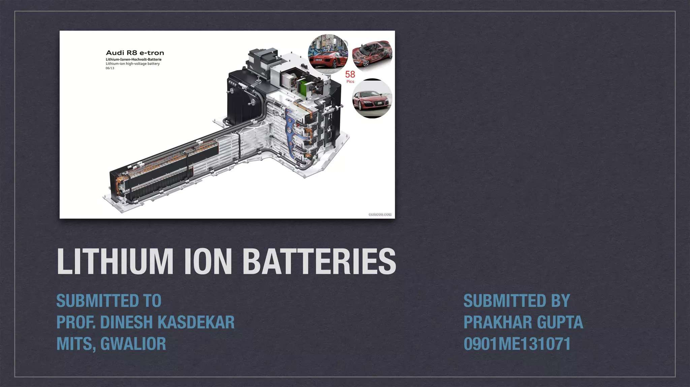

Slide 6
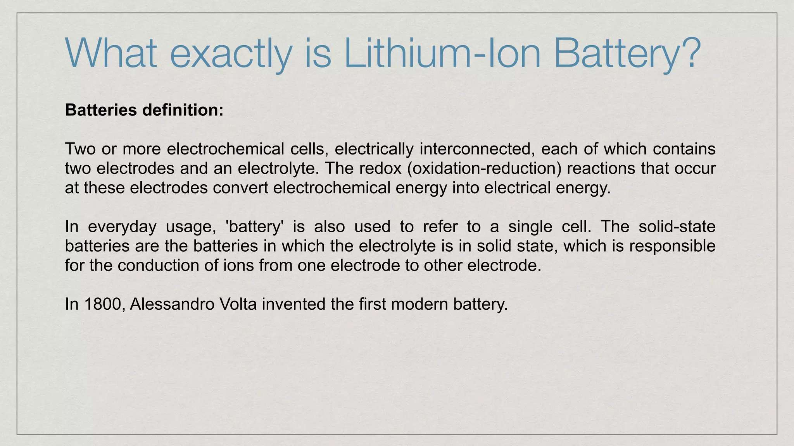


Slide 7
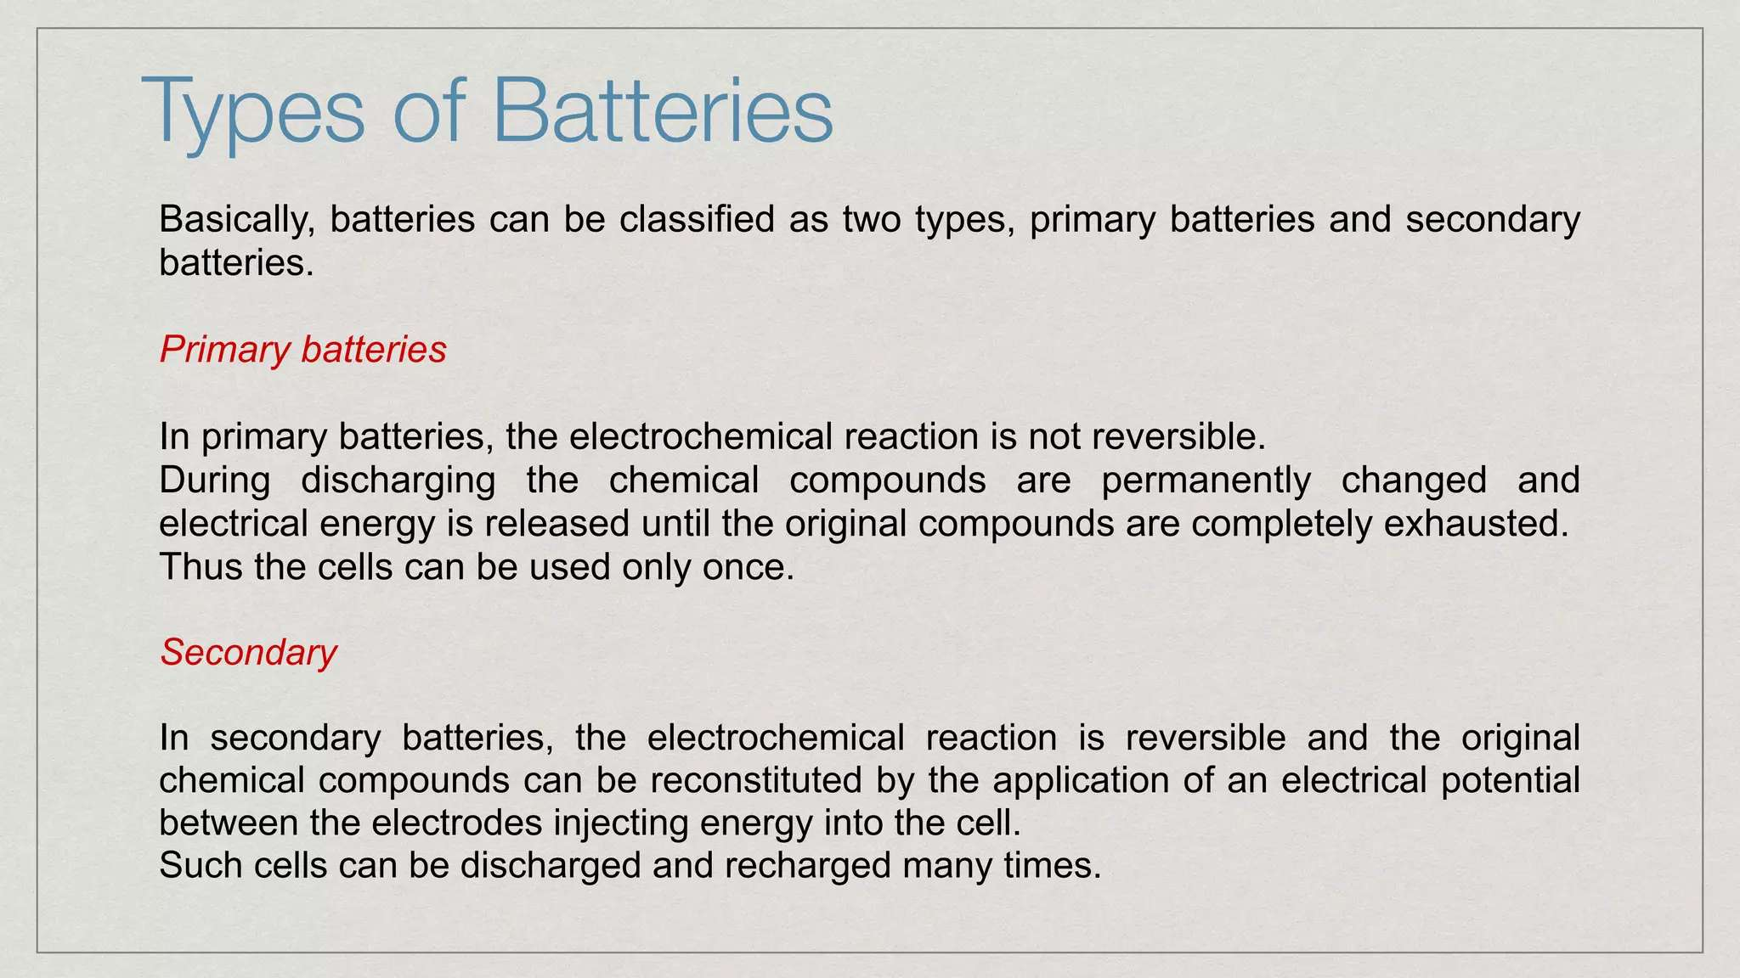

Slide 8
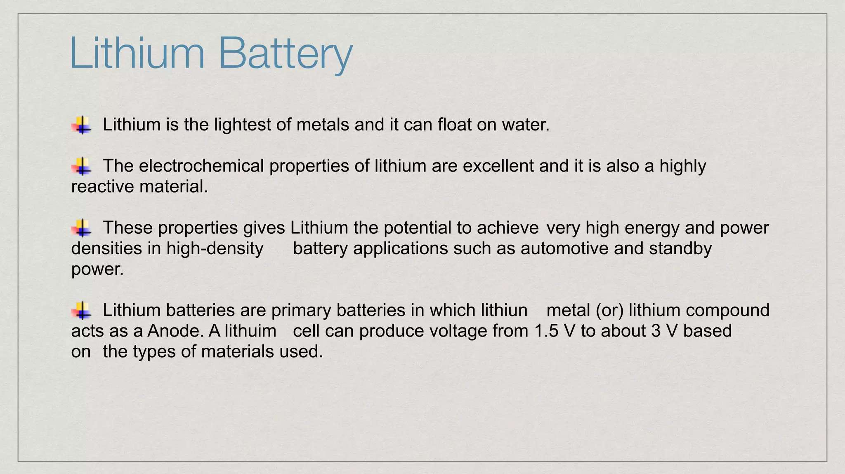

Slide 9
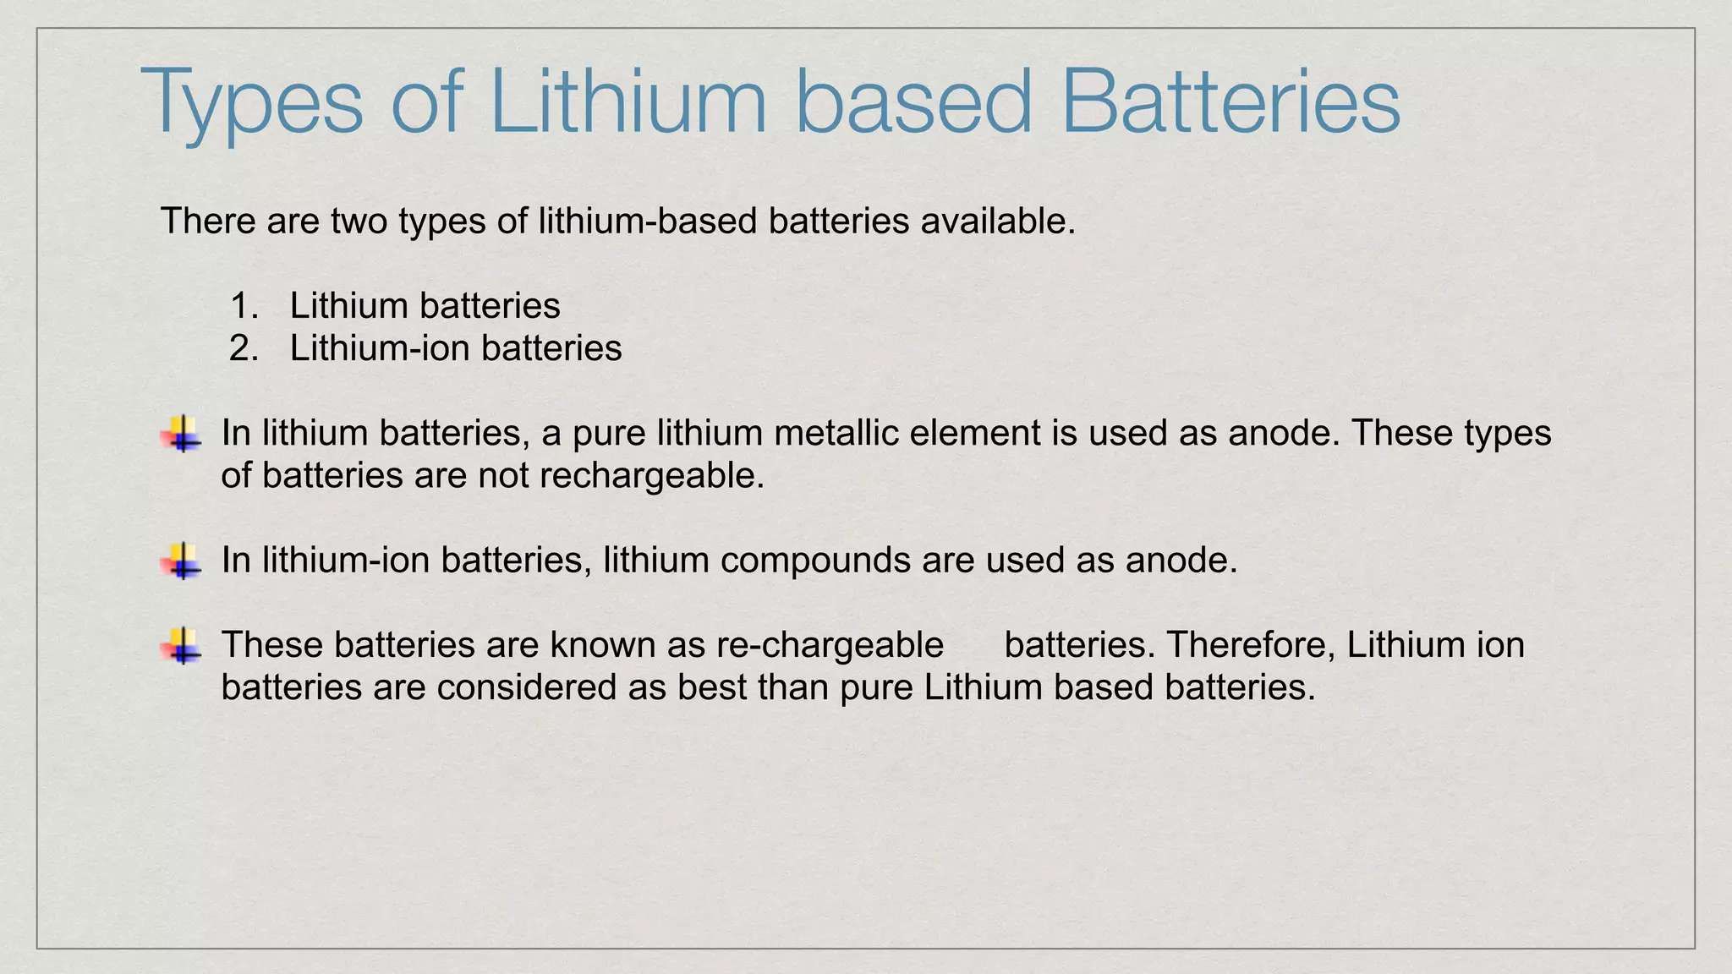

Slide 10
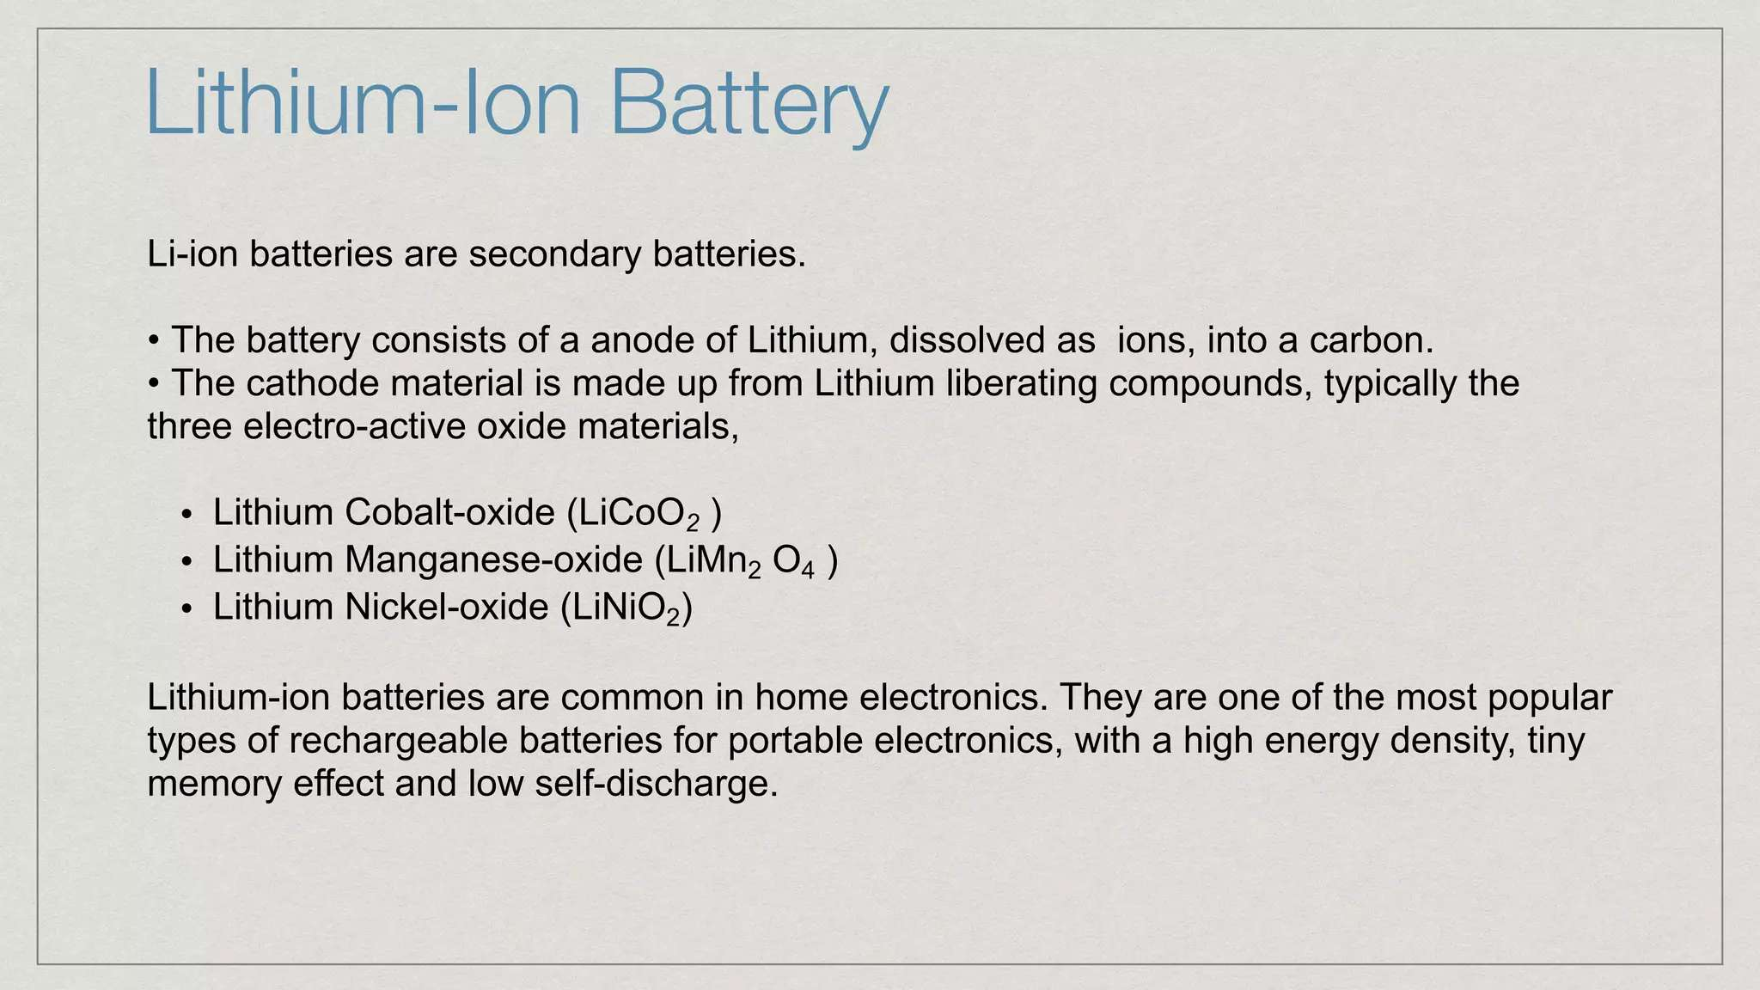

Slide 11
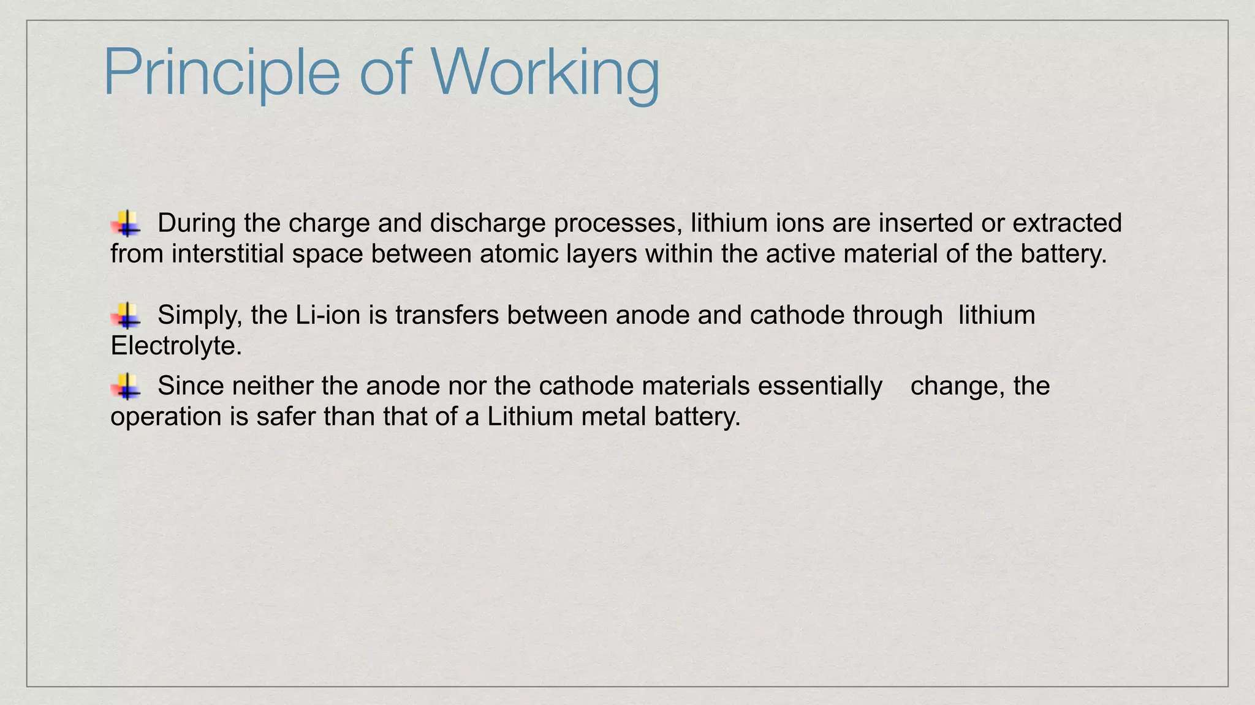

Slide 12
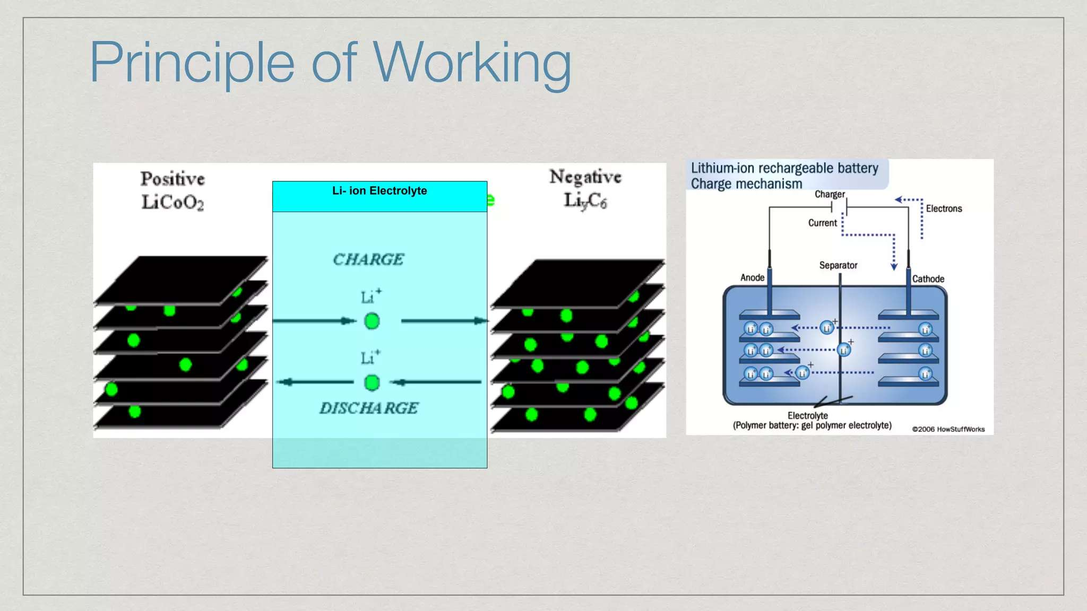

Slide 13
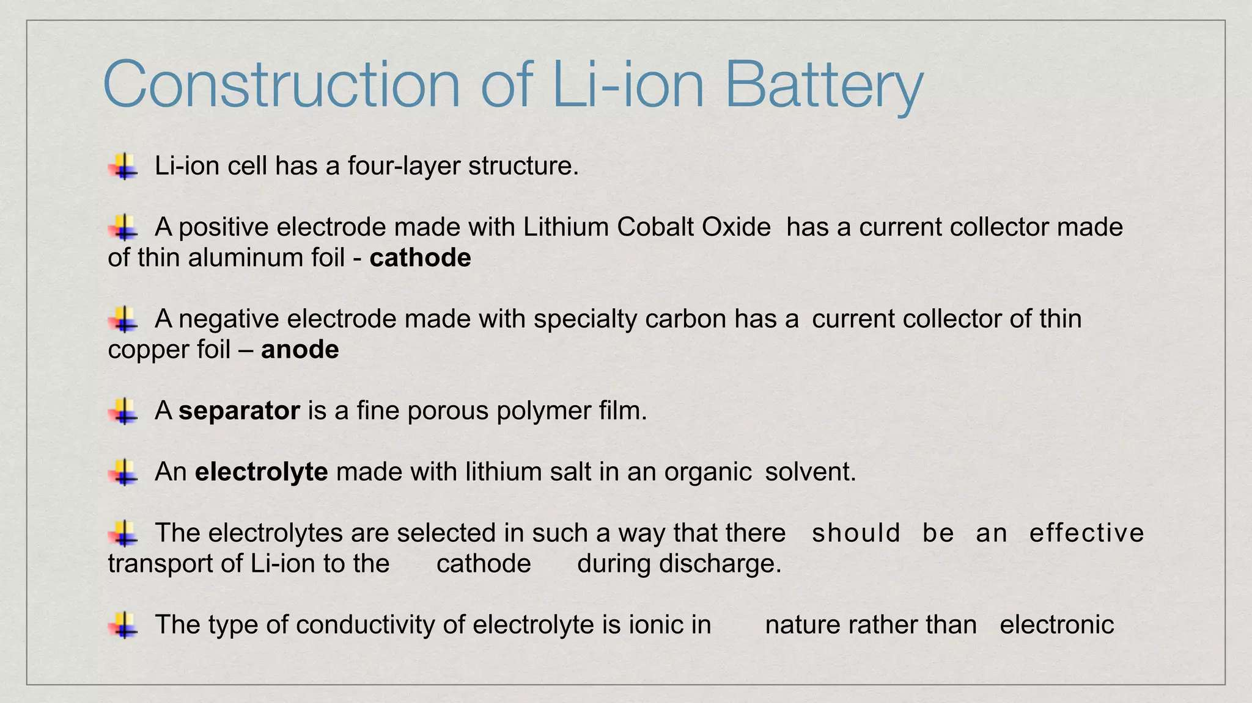

Slide 14
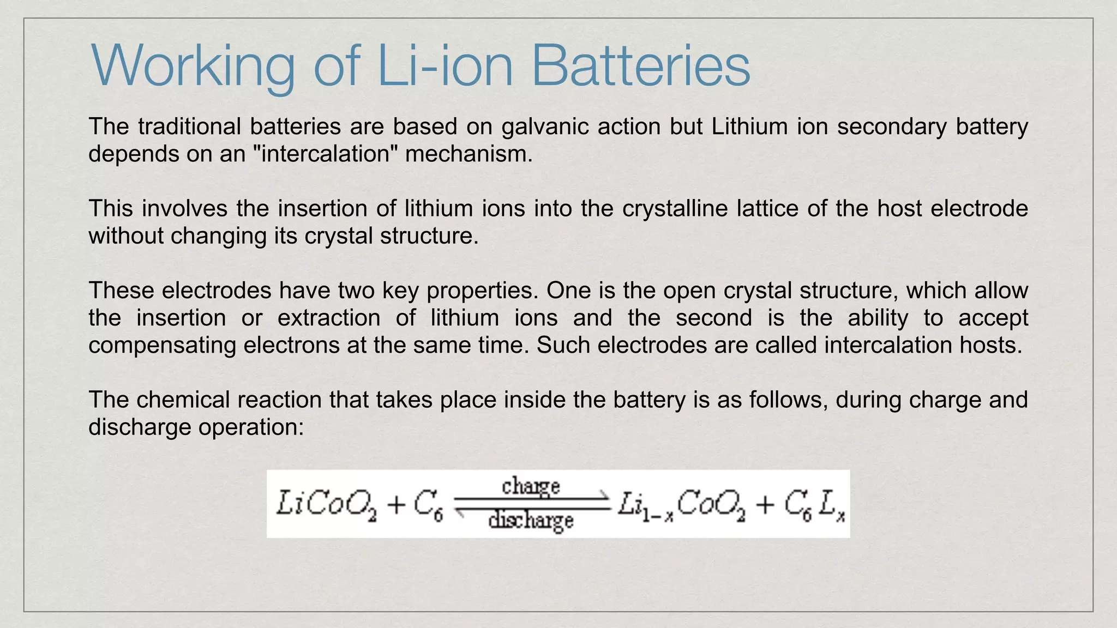

Slide 15
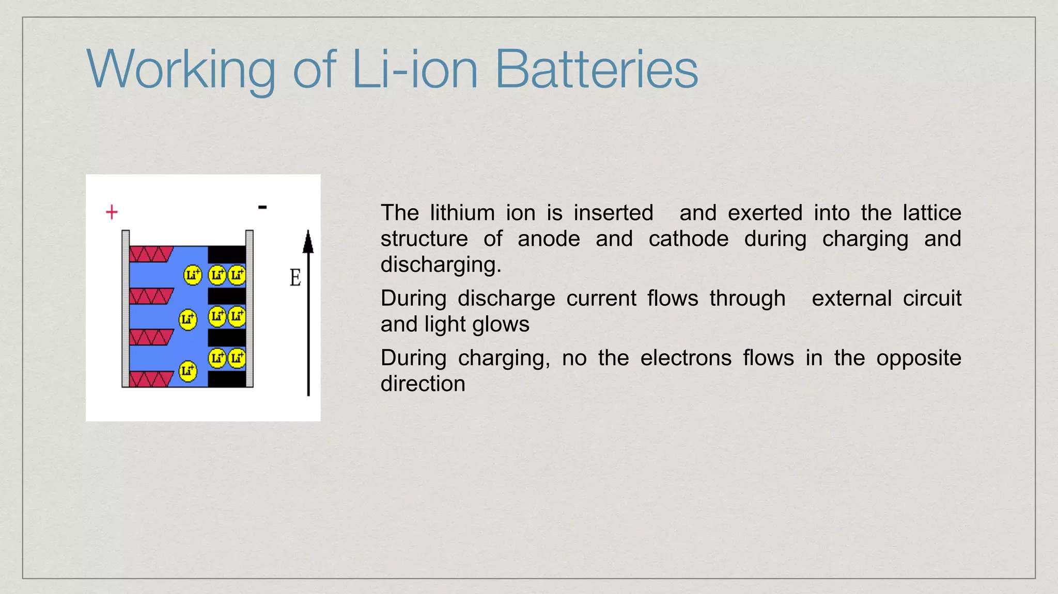

Slide 16
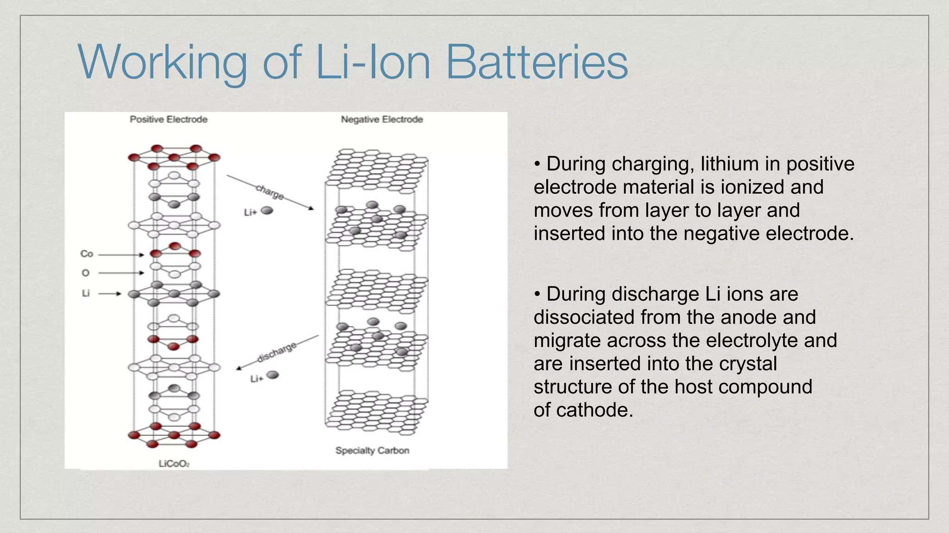

Slide 17
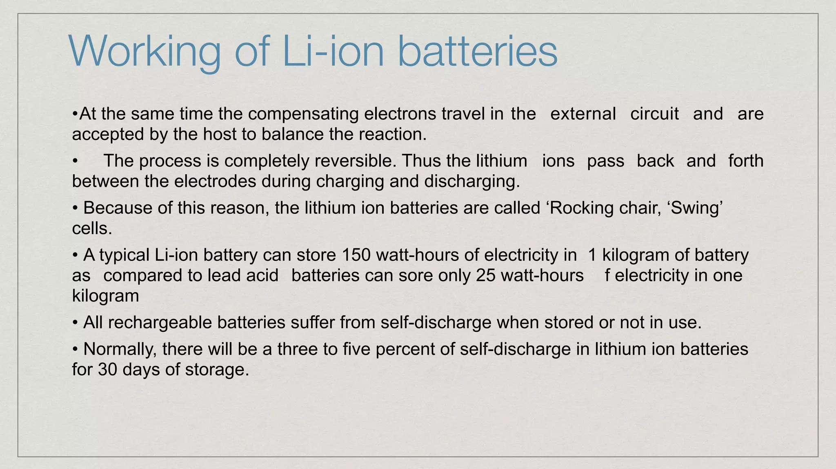

Slide 18
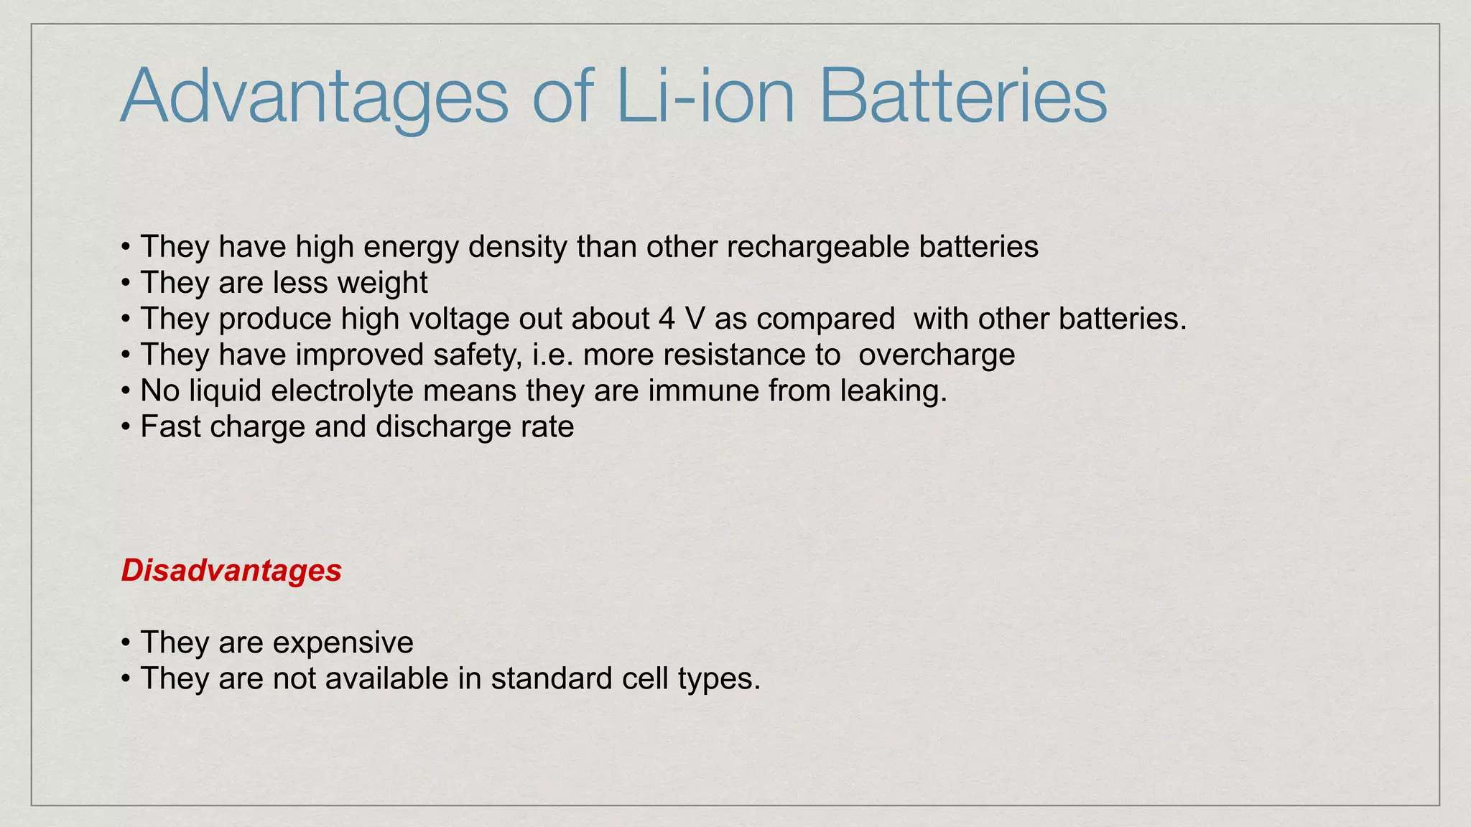

Slide 19
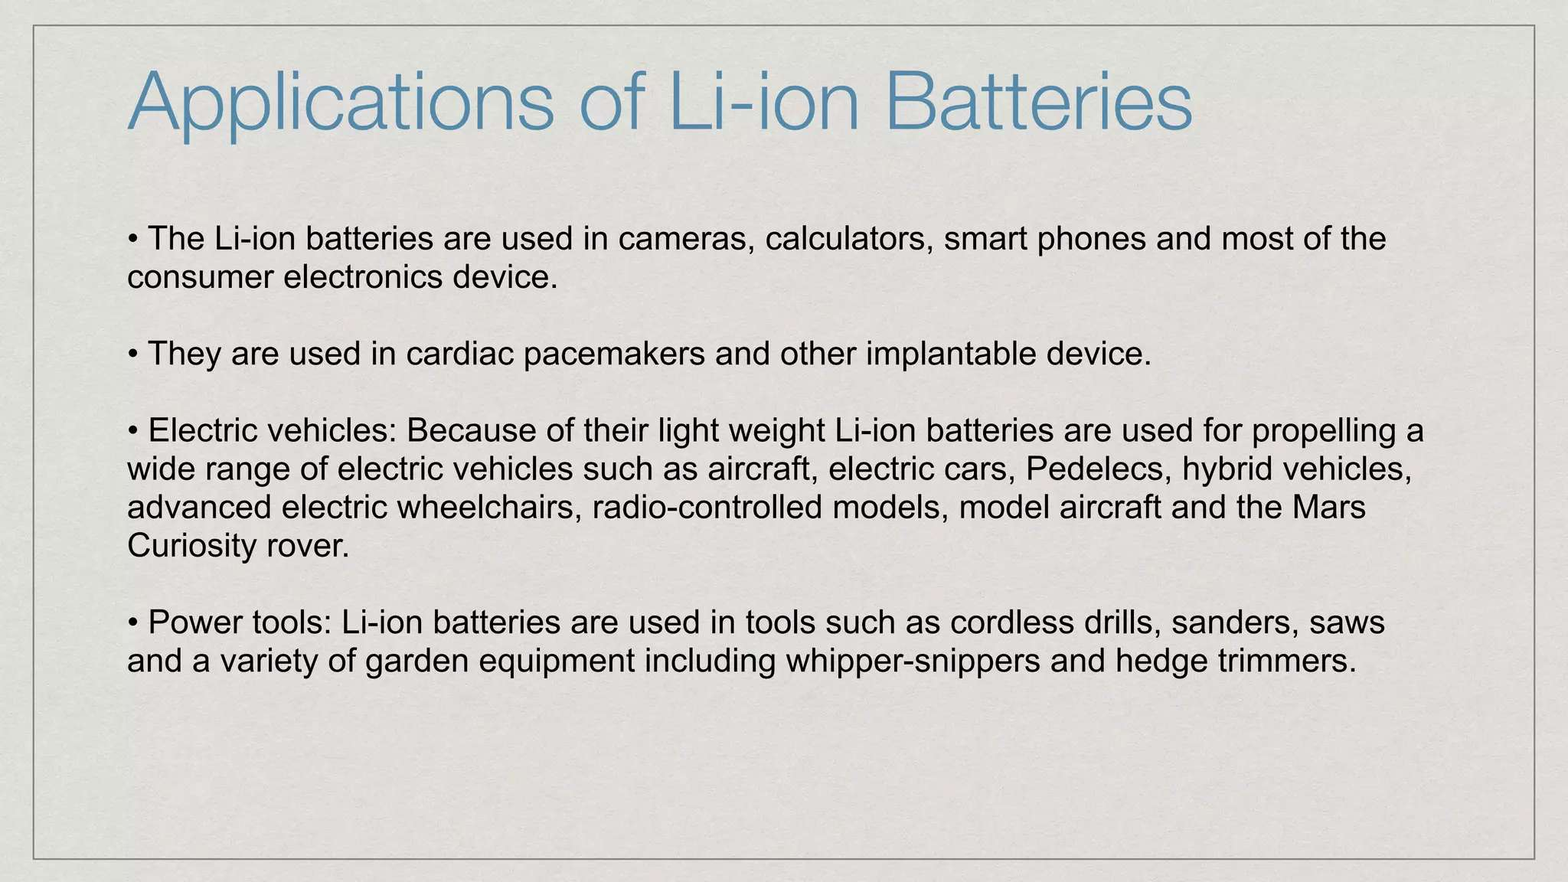

Slide 20
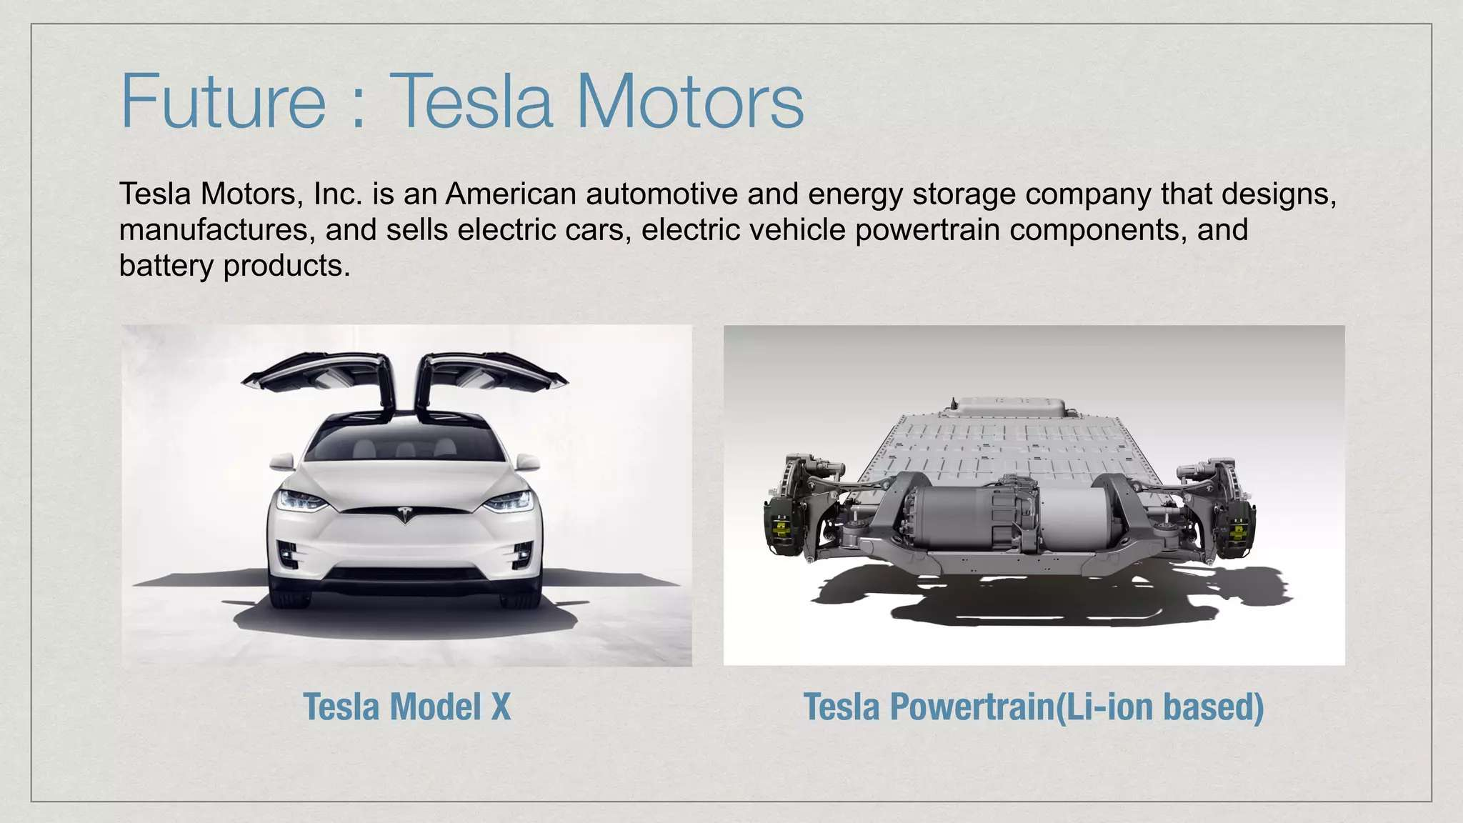

Slide 21
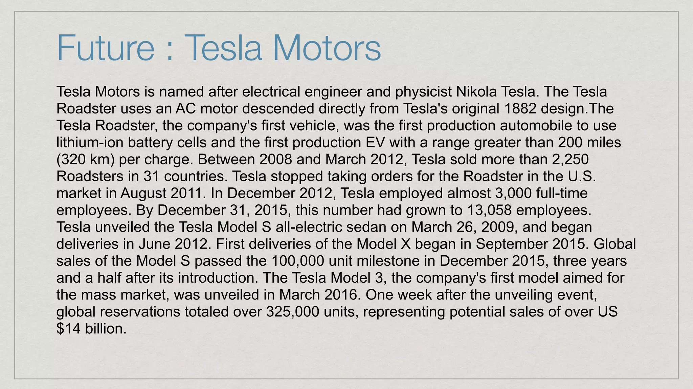

Slide 22
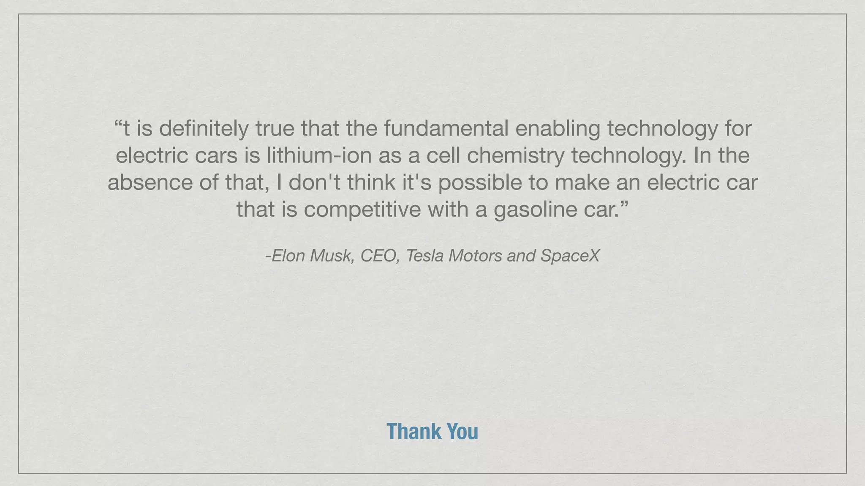

Slide 23
Q&A
🔹 Q1. MCQ
Which of the following is the anode material commonly used in lithium-ion batteries? a) Lead b) Zinc c) Graphite d) Copper
✅ Correct Answer: c) Graphite
🔹 Q3. Short Answer
Write the overall reaction for a typical lithium-ion battery during discharge.
✅ Answer: LiCoO₂ + C ⇌ Li₁₋ₓCoO₂ + LixC (where x ≈ 0.5–0.6) (Simplified: Lithium ions move from anode to cathode.)
🔹 Q2. MCQ
The electrolyte used in lithium-ion batteries is usually: a) Concentrated sulfuric acid b) Potassium hydroxide solution c) Organic solvent with lithium salt d) Ammonium chloride paste
✅ Correct Answer: c) Organic solvent with lithium salt
🔹 Q5. Short Answer
List two applications of lithium-ion batteries in daily life.
✅ Answer:
Mobile phones
Electric vehicles (Others: Laptops, drones, power tools, etc.)
🔹 Q4. MCQ
One of the major advantages of lithium-ion batteries is: a) Low voltage b) Heavy weight c) Memory effect d) High energy density
✅ Correct Answer: d) High energy density

Slide 24
📚 Key Takeaways:
Lithium-ion (Li-ion) batteries are rechargeable secondary cells known for high energy density and efficiency.
A typical Li-ion battery uses:
Graphite anode
LiCoO₂ (or LiFePO₄) cathode
Organic liquid electrolyte with lithium salt (e.g., LiPF₆)
During discharge, Li⁺ ions move from anode to cathode, releasing electrical energy.
Advantages:
Lightweight
No memory effect
High cycle life
Fast charging
Compact size
Disadvantages:
Sensitive to high temperatures
Requires protection circuit
Higher cost than traditional batteries
Used extensively in smartphones, laptops, EVs, pacemakers, drones, and power backups.

Slide 25
📚 Textbook References
Author(s) | Title | Publisher | Relevant Chapter/Pages
P.W. Atkins & Julio de Paula | Physical Chemistry | Oxford University Press | Ch. 19: Electrochemistry, pp. 680–690
Bahl & Tuli | Essentials of Physical Chemistry | S. Chand Publishing | Ch. 9: Modern Batteries, pp. 675–688
K.L. Kapoor | Electrochemistry & Solutions (Vol. 3) | Macmillan India | Ch. 5: Secondary Cells – Li-ion, pp. 125–138
Sharma & Kaur | Physical Chemistry | Krishna Prakashan | Electrochemical Cells chapter – Li-ion section
Gurdeep Raj | Advanced Physical Chemistry | Goel Publishing | Section: Lithium-based batteries

